Slide 1


VYAKTA
Inclusive Communication
Team VYAKTA
PRESENTED BY
[name here]

Slide 2
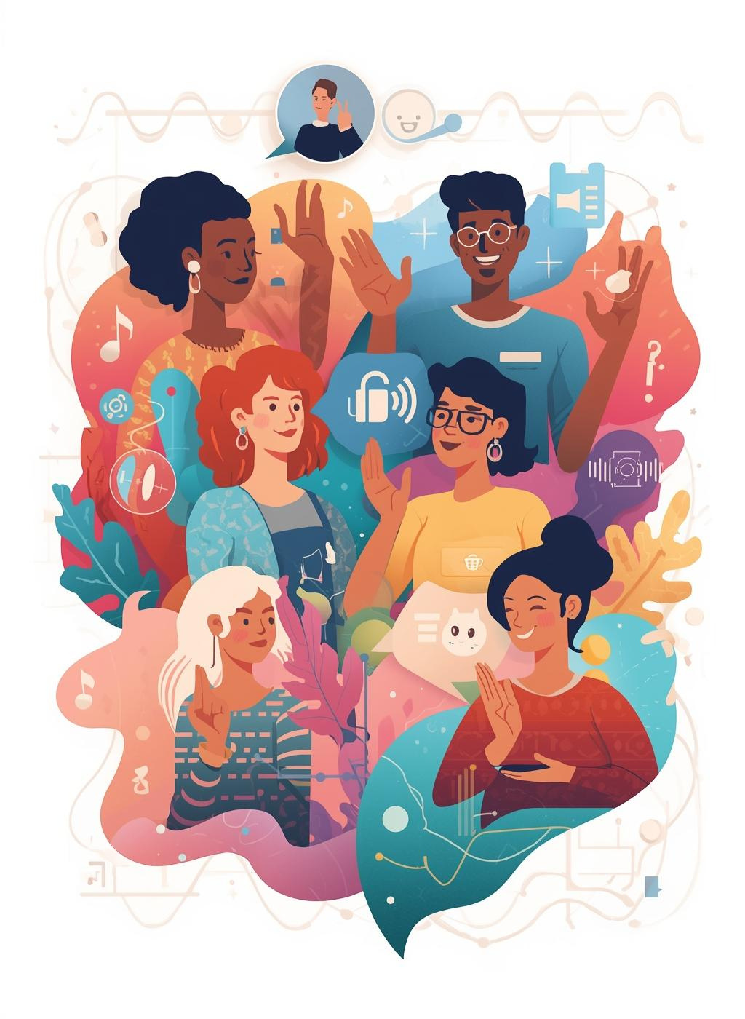
Bridging Silence
VYAKTA is a revolutionary AI-powered platform that serves as a real-time translator, connecting sign language and spoken language, fostering inclusive communication for everyone.

Slide 3
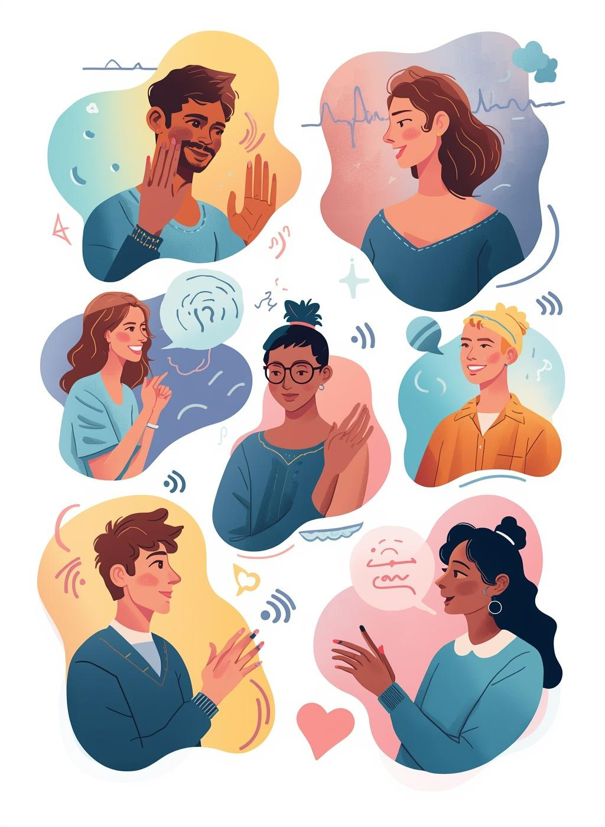
Connecting Sign and Spoken Languages
VYAKTA serves as a transformative bridge between hearing and speech-impaired individuals, enhancing communication in real-time through innovative AI technology that empowers connections.

Slide 4

The Problem
Communication barriers remain a significant challenge for hearing and speech-impaired individuals, leading to missed opportunities and social isolation in both personal and professional contexts.

Slide 5

430 million
People live with hearing loss
Globally, 430 million individuals experience disabling hearing loss, with a significant portion in India, highlighting the urgent need for effective communication solutions like VYAKTA.

Slide 6

The Solution
VYAKTA’s AI-driven platform revolutionizes communication by providing real-time translation between sign language and spoken languages, empowering individuals to connect effortlessly and inclusively.

Slide 7
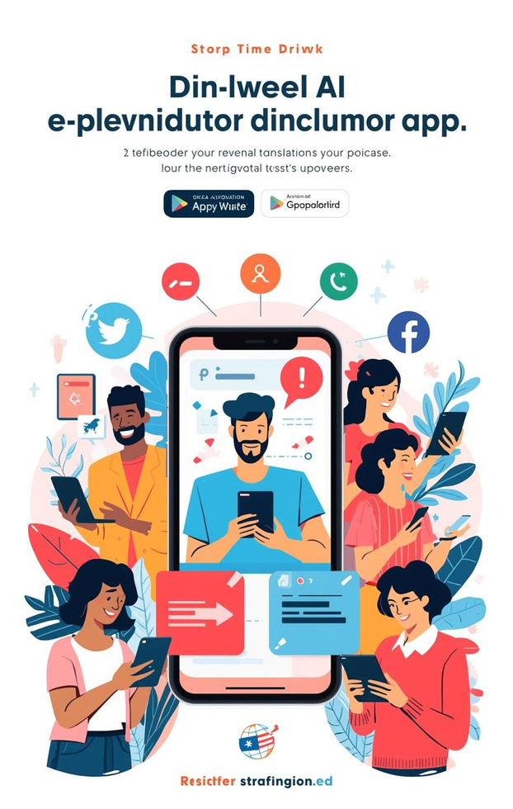

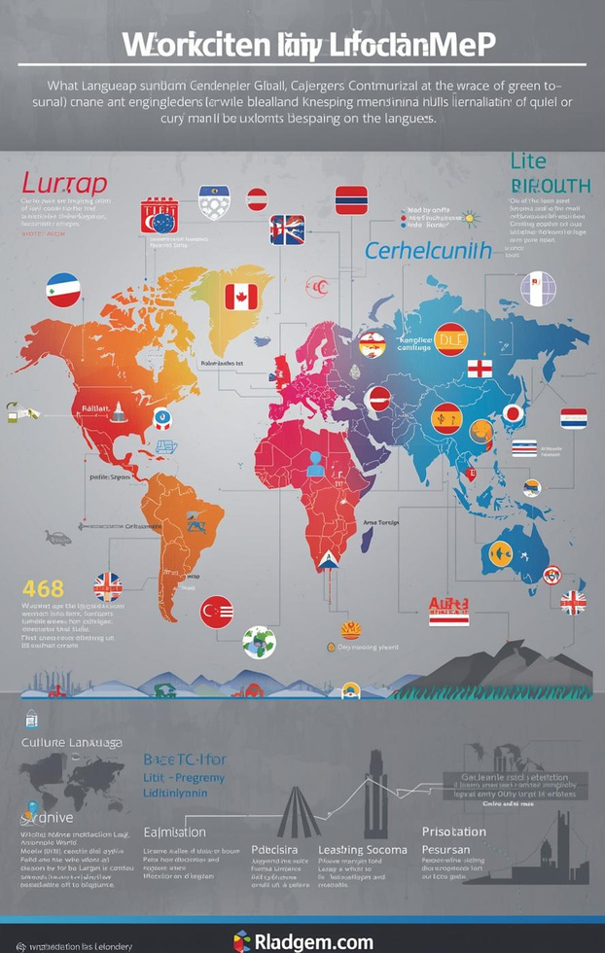
Unique Selling Points
REAL-TIME TRANSLATION
Instant communication
INCLUSIVE DESIGN
User-friendly interface
GLOBAL REACH
300+ languages

Slide 8
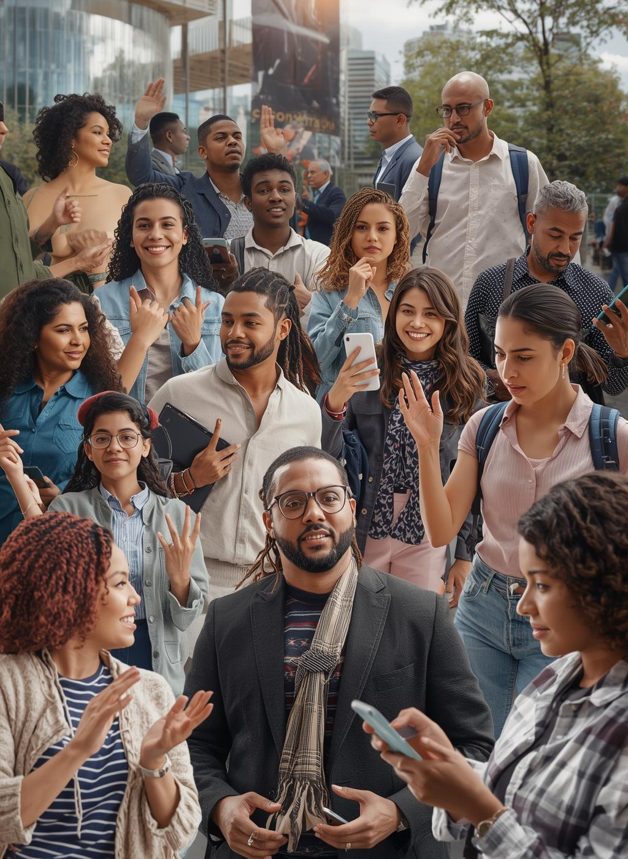
₹3.3-4.1 Lakh Cr
Total Addressable Market (TAM)
The total addressable market for VYAKTA reflects a significant opportunity within the inclusive communication sector, addressing diverse needs globally while enhancing accessibility for millions.

Slide 9

Target Audience
The primary users of VYAKTA include sign language users, verbal speakers, families, institutions, and corporates, emphasizing inclusivity across diverse sectors like education, healthcare, and government.

Slide 10
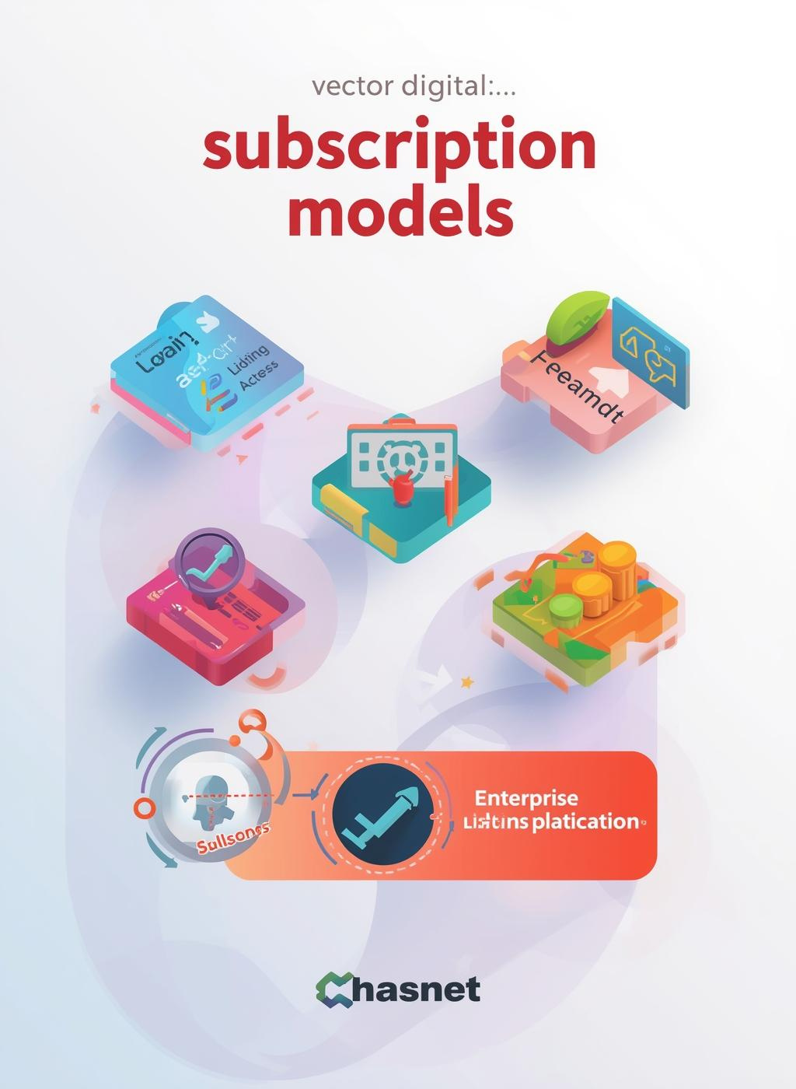
Business Model
VYAKTA employs a diverse revenue model including freemium access, tiered subscriptions, and enterprise licensing, ensuring accessibility for individuals while generating sustainable income through organizations.

Slide 11
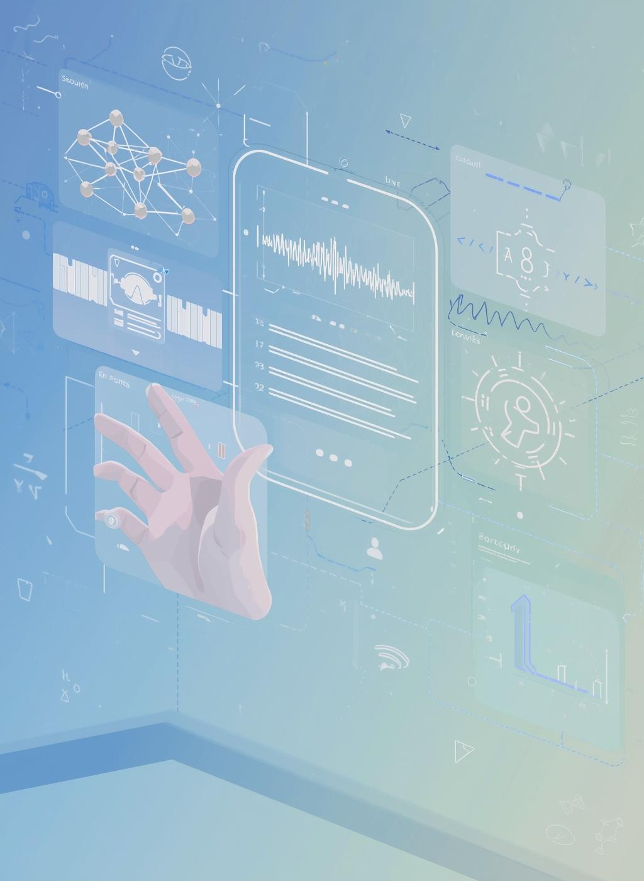
Technology Implementation
VYAKTA harnesses advanced AI Vision, NLP, and Speech Recognition technologies to enable seamless communication, transforming how we connect across languages and abilities.

Slide 12
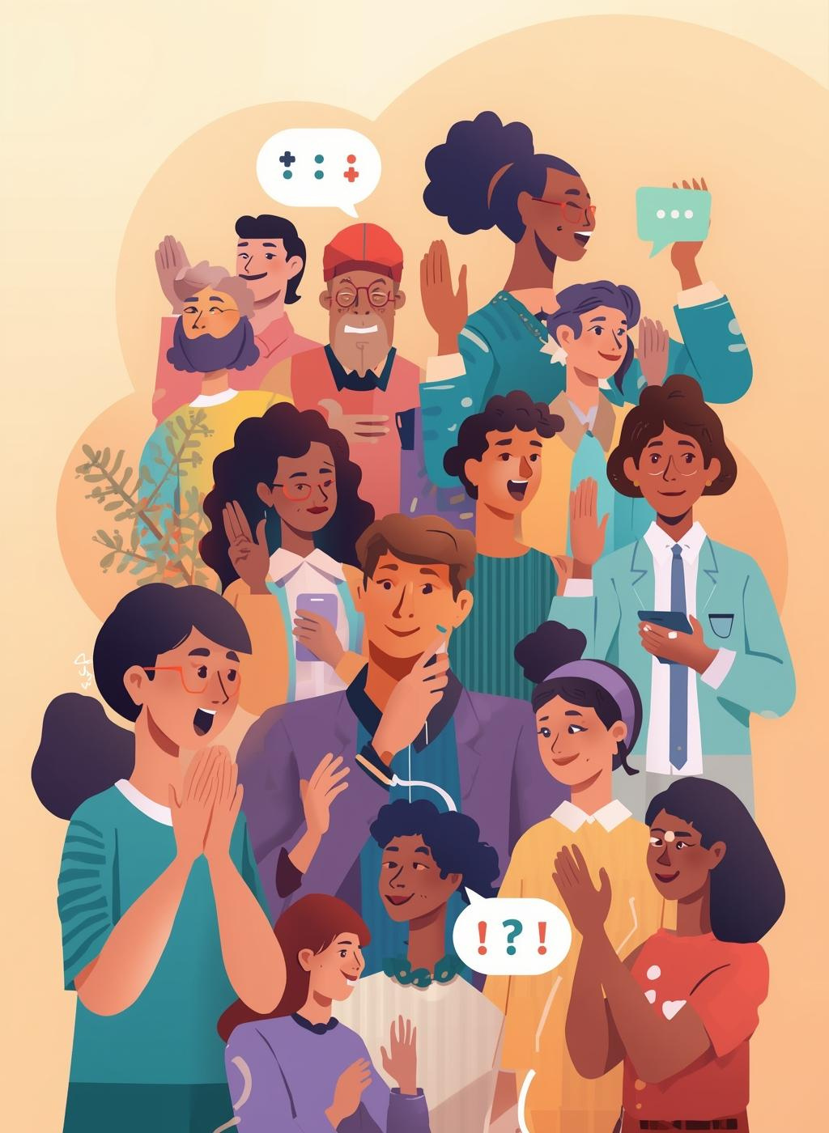
Vision
“Let’s build a world where conversation has no barriers…”
– VYAKTA TEAM

Slide 13

Contact Us
VYAKTA TEAM
@reallygreatsite
LOCATION
(12) 3456-7890
COLLABORATIONS
hello@reallygreatsite

